Slide 1
Analytical Methods for Business
Dr. Ronald K. Satterfield
Muma College of Business
University of South Florida

Slide 2
Module 1 Introduction
Dr. Ronald K. Satterfield
Muma College of Business
University of South Florida
Getting Started with Statistics

Slide 3
Plan for This Presentation
Basic Introduction to the Course
Software Used
Reasons for Studying Statistics
How Statistics Works
Types of Data
Types of Sampling
Questionnaires
Descriptive Statistics
Graphical Tools
Introduction | Types of Data | Types of Sampling | Descriptive Statistics | Graphical Tools | Conclusion

Slide 4
Textbook Coverage
Raykov and Marcoulides, Chapters 1 and 2
Brown and Murdoch, Chapters 1 and 2
Introduction | Types of Data | Types of Sampling | Descriptive Statistics | Graphical Tools | Conclusion

Slide 5
Major Course Objectives
NOT to Make You an Expert
Let You Talk to the Experts
Let You Ask Questions
Understand Terminology
Let You Evaluate Statistical Work Done By Others
Prepare You for Statistical Data Mining
Introduction | Types of Data | Types of Sampling | Descriptive Statistics | Graphical Tools | Conclusion

Slide 6
Tools Taught
Types of Data
Methods of Getting Data
Normal and Other Distributions
Central Limit Theorem
Sampling Distributions
Confidence intervals
Hypothesis Testing
Simple Regression
Multiple Regression
Logistic Regression
Analysis of Variance (ANOVA)
Introduction | Types of Data | Types of Sampling | Descriptive Statistics | Graphical Tools | Conclusion

Slide 7
Analyzing and Visualizing Common Software
SPSS
SAS
Minitab
Excel
R
Tableau
JMP
Introduction | Types of Data | Types of Sampling | Descriptive Statistics | Graphical Tools | Conclusion

Slide 8
Statistics in Business
Data Science (Data Analytics, ʺBig Dataʺ)
Data Mining & Warehousing
Visualization
Marketing Research
Customer Service
Risk Management
Proving Regulatory Conformity
Quality Control
Auditing
Financial Analysis
Introduction | Types of Data | Types of Sampling | Descriptive Statistics | Graphical Tools | Conclusion

Slide 9
Assumptions
You’ve Installed R
You’ve Installed R Studio
Introduction | Types of Data | Types of Sampling | Descriptive Statistics | Graphical Tools | Conclusion

Slide 10
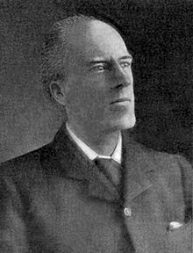
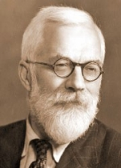
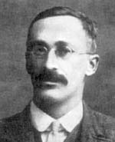
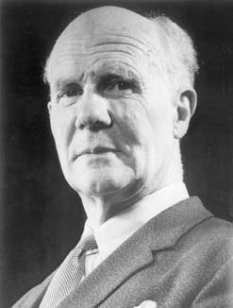
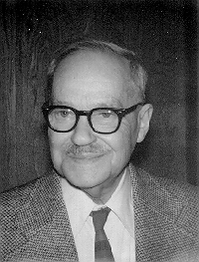
The Critical Originators
William Gosset
Egon Pearson
Jerzy Neyman
Karl Pearson
R. A Fisher
Introduction | Types of Data | Types of Sampling | Descriptive Statistics | Graphical Tools | Conclusion

Slide 11
The Statistical Revolution
The Victorian View
Our View
The Statistical Revolution
The Universe is Deterministic
The Universe is Stochastic
Karl Pearson
R. A Fisher
Introduction | Types of Data | Types of Sampling | Descriptive Statistics | Graphical Tools | Conclusion

Slide 12
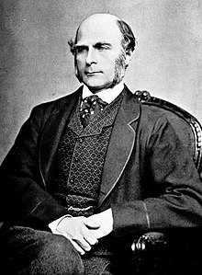
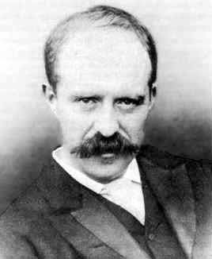
Biometrika – Publishing Statistical Research
Karl Pearson
Francis Galton
William Gosset
Introduction | Types of Data | Types of Sampling | Descriptive Statistics | Graphical Tools | Conclusion

Slide 13
Important Terms
Descriptive vs. Inferential Statistics
Population
Variable
Mean (Statistic)
Sample (Biased and Unbiased)
Statistical Tests
Introduction | Types of Data | Types of Sampling | Descriptive Statistics | Graphical Tools | Conclusion

Slide 14
Types of Data
Qualitative
Categorical
Nominal
Discrete
Ordinal
Interval
Continuous
Ratio
Quantitative
Numerical
Introduction | Types of Data | Types of Sampling | Descriptive Statistics | Graphical Tools | Conclusion
Notes:
14

Slide 15
Formatting of Data
Structured – Follows some organization, pattern, or plan
Unstructured – No repeating pattern. A challenge for Organizing
Introduction | Types of Data | Types of Sampling | Descriptive Statistics | Graphical Tools | Conclusion

Slide 16
Sources of Data
Published Source
Direct Observation
Designed Experiment
Survey (Questionnaires)
Introduction | Types of Data | Types of Sampling | Descriptive Statistics | Graphical Tools | Conclusion

Slide 17
Types of Sampling
Probability Sample – Elements are selected from a population based on known probabilities in the population.
Nonprobability Sample – Elements are selected from a population with no knowledge of probabilities in the population.
Convenience Sample – Just like the name says, it’s easy.
Judgement Sample – Collect opinions of preselected experts.
Introduction | Types of Data | Types of Sampling | Descriptive Statistics | Graphical Tools | Conclusion

Slide 18
Types of Sampling
Simple Random Sample – Every element has an equal chance of being chosen.
Systematic Sample – Taking every nth element in a population of N size.
Stratified Sample – Divide the population by some known characteristic, then take a simple random sample from each group.
Cluster Sample – Similar to Stratified. Divide the population by some naturally occurring cluster (geography, political boundaries, etc.) and take samples from each cluster.
Introduction | Types of Data | Types of Sampling | Descriptive Statistics | Graphical Tools | Conclusion

Slide 19
Central Tendency & Variation
Introduction | Types of Data | Types of Sampling | Descriptive Statistics | Graphical Tools | Conclusion

Slide 20
Descriptive Statistics – Pearson’s Four Parameters
Mean
Standard Deviation
Skewness (Symmetry)
Kurtosis
Introduction | Types of Data | Types of Sampling | Descriptive Statistics | Graphical Tools | Conclusion

Slide 21
Descriptive Statistics – Other Useful Measures
Median
Variance
Quartiles
Introduction | Types of Data | Types of Sampling | Descriptive Statistics | Graphical Tools | Conclusion

Slide 22
R Packages to Install
Introduction | Types of Data | Types of Sampling | Descriptive Statistics | Graphical Tools | Conclusion

Slide 23
R Commands
Introduction | Types of Data | Types of Sampling | Descriptive Statistics | Graphical Tools | Conclusion

Slide 24
Describing Data Graphically
Histogram
Stem and Leaf Plot
Box Plot
Scatterplot
Introduction | Types of Data | Types of Sampling | Descriptive Statistics | Graphical Tools | Conclusion

Slide 25
What Have We Covered?
Reasons for Studying Statistics
The Basic Statistical Model
Types and Sources of Data
Methods of Sampling
Descriptive Statistics
Graphical Tools
Introduction | Types of Data | Types of Sampling | Descriptive Statistics | Graphical Tools | Conclusion

Slide 26
For Completing Assignments
set.seed(numerical portion of your U number 9 digits)
some.grades=grades[sample(1:nrow(grades),5,replace=FALSE),]
attach(some.grades)

